Slide 1
Dancing Monkeys: Accelerated
GPU-Accelerated Beat Detection for Dancing Monkeys
Philip Peng, Yanjie Feng
UPenn CIS 565 Spring 2012
Final Project – Midpoint Presentation
img src: http://www.dcrblogs.com/wp-content/uploads/2010/03/radioactive-dancing-monkeys-fastest-ani.gif

Slide 2

Project Description
Dancing Monkeys
Create DDR step patterns from arbitrary songs
Highly precise beat detection algorithm (accurate within <0.0001 BPM)
Nov 1, 2003 by Karl O’Keeffe
MATLAB program, CC license
http://monket.net/dancing-monkeys-v2/
GPU Acceleration
Algorithm used = brute force BPM comparisons
GPUs are good with parallel number crunching!
img src: http://monket.net/uploaded-v2/Feet.png

Slide 3
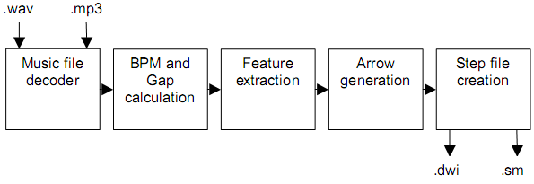
Dancing Monkeys Architecture
Process waveform data
Calculate BPM (first pass)
Calculate BPM (second pass)
Calculate gap time
Generate arrow patterns from waveform data

Slide 4
Timing Breakdown
Process | Time (s)
timeProgram | 202.748426
timeArgs | 0.082273
timeSong | 202.651163
timePrep | 9.432683
timeInfo | 7.371580
timeData | 1.797109
timePeaks | 0.253459
timeBpm1 | 185.960192
timeTest | 126.409699
timeTestTop | 0.002460
timeFit | 59.377492
timeFitBest | 0.154692
Process | Time (s)
timeBpm2 | 1.200393
timeTest | 1.184987
timeTestTop | 0.000064
timeFit | 0.000122
timeFitBest | 0.006139
timeGap | 1.663195
timeEnergy | 0.040256
timeSimilar | 1.617153
timeGenerate | 4.375886
timeCliques | 0.035418
timePause | 0.431286
timeArrow | 0.350256
timeOutput | 3.546520

Slide 5
Timing Breakdown

Slide 6
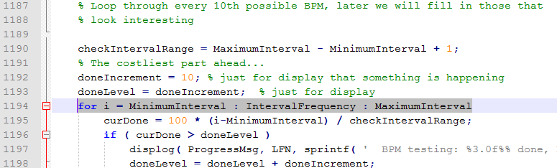
Code Analysis
timeBPM (first pass) longest: brute force BPM comparisons
BPM [89, 205], Frequency = 44100
Interval = round(Frequency / (BPM / 60));
Interval = [12907, 29730], IntervalFrequency = 10
Total of 1682 loops

Slide 7

CPU Parallelization - Approach
MATLAB’s Parallel Computing Toolbox
Replace for loops with MATLAB’s parfor
Run loop in parallel, one per CPU core
http://www.mathworks.com/help/toolbox/distcomp/parfor.html
Require code modification
matlabpool
Temporary arrays
Index recalculations

Slide 8
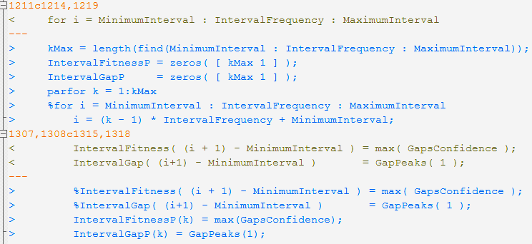
CPU Parallelization - Code

Slide 9
CPU Parallelization - Results
 | base | parfor | %
timeTest | 126.4 | 47.2 | 37.5%
timeFit | 59.3 | 30.4 | 51.3%
timeBpm | 186.0 | 77.7 | 41.8%
timeProgram | 202.7 | 93.3 | 46.0%

Slide 10

GPU Parallelization - Approach
MATLAB’s gpuArray() and gather() function
MATLAB’s build-in GPU functions
Parallel GPU kernel by using arrayfun()
http://www.mathworks.com/help/toolbox/distcomp/bsic3by.html

Slide 11
GPU Parallelization - Issues
Global variables/data structures
Rewrite code
Loops -> GPU Kernel functions
Data -> eliminate their cohesion and modify their type so that they can be used in GPU Kernel
Slow memory copy
 | base | With data transform | %
timeProgram | 26.6 | 49.2 | 185.0%

Slide 12
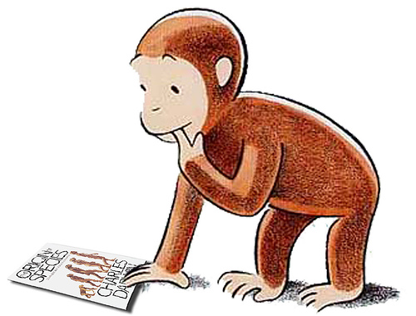
Questions?
Blog: http://dancingmonkeysaccelerated.blogspot.com/
Code: https://github.com/Keripo/DancingMonkeysAccelerated
img src: http://www.gratuitousscience.com/wp-content/uploads/2010/04/6a00d83451f25369e200e54f94996e8834-800wi.jpg

